Slide 1

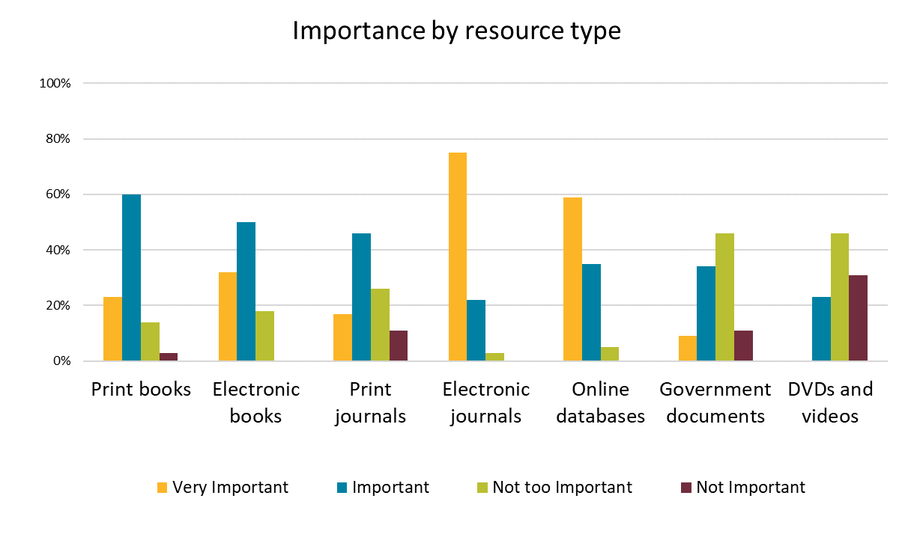
Creating a Conference Poster in Microsoft PowerPoint:
A Template
Thomas La Foe†, Stephanie Agnew†, and Pattye Archer‡
†Mississippi State University, ‡Mississippi University for Women
Background
Results
Conclusions
Official MSU Colors
Video provides a powerful way to help you prove your point. When you click Online Video, you can paste in the embed code for the video you want to add. You can also type a keyword to search online for the video that best fits your document. To make your document look professionally produced, Word provides header, footer, cover page, and text box designs that complement each other. For example, you can add a matching cover page, header, and sidebar. Click Insert and then choose the elements you want from the different galleries.
Save time in Word with new buttons that show up where you need them.
To change the way a picture fits in your document, click it and a button for layout options appears next to it.
When you work on a table, click where you want to add a row or a column, and then click the plus sign. Save time in Word with new buttons that show up where you need them.
To change the way a picture fits in your document, click it and a button for layout options appears next to it.
When you work on a table, click where you want to add a row or a column, and then click the plus sign.
Save time in Word with new buttons that show up where you need them.
To change the way a picture fits in your document, click it and a button for layout options appears next to it.
When you work on a table, click where you want to add a row or a column, and then click the plus sign.
Objectives
Save time in Word with new buttons that show up where you need them.
To change the way a picture fits in your document, click it and a button for layout options appears next to it.
When you work on a table, click where you want to add a row or a column, and then click the plus sign.
Methodology
0.5” Square that can be
used for measuring
margins and spacing
Video provides a powerful way to help you prove your point. When you click Online Video, you can paste in the embed code for the video you want to add. You can also type a keyword to search online for the video that best fits your document. To make your document look professionally produced, Word provides header, footer, cover page, and text box designs that complement each other. For example, you can add a matching cover page, header, and sidebar. Click Insert and then choose the elements you want from the different galleries. Video provides a powerful way to help you prove your point. When you click Online Video, you can paste in the embed code for the video you want to add. You can also type a keyword to search online for the video that best fits your document.
Acknowledgements
Video provides a powerful way to help you prove your point. When you click Online Video, you can paste in the embed code for the video you want to add. You can also type a keyword to search online for the video that best fits your document. To make your document look professionally produced, Word provides header, footer, cover page, and text box designs that complement each other. For example, you can add a matching cover page, header, and sidebar. Click Insert and then choose the elements you want from the different galleries. Video provides a powerful way to help you prove your point.
Official Logos and Colors for Mississippi State University
https://www.brand.msstate.edu/assets/index.php
Principles of Poster Design Tutorial from the MaxxSouth Digital Media Center
https://guides.library.msstate.edu/dmc/powerpoint

